Slide 1
Fake News Detection Project

Slide 2
Problem Statement
To detect the fake news.
The data for this project was obtained from kaggle website. There are two dataset, one containing all the true news and another containing all the fake news.

Slide 3
Background
Fake news has become one of the biggest problems of our age. It has serious impact on our online as well as offline discourse. One can even go as far as saying that, to date, fake news poses a clear and present danger to western democracy and stability of the society.
Data science can play a key role in this domain by helping user distinguish fake news from real.

Slide 4
Data Analysis
First step is to create and insert label column named ‘report’ in both the dataset.
In fake news dataset the report column will have all the input values as zeros whereas for true news dataset the report column will have all the input values as ones.
Both the dataset are then combined using pandas built-in function.

Slide 5
Next we get insight of the dataset by determining the shape of data and finding the data type. In this phase, we found that politics news category was repeated twice due to mislabelling. Hence we relabelled the category and proceeded ahead.
Later we perform null value analysis to detect any missing data. Since there were no null values detected in our dataset, we move to next step.
Using visualization techniques we perform univariate, bivariate analysis.

Slide 6
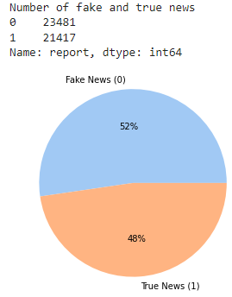
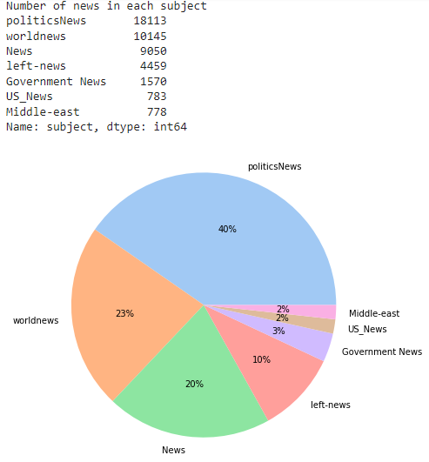
There are 23481 fake news and 21417 true news in the dataset.
- PoliticsNews is the news category with highest number of news.

Slide 7
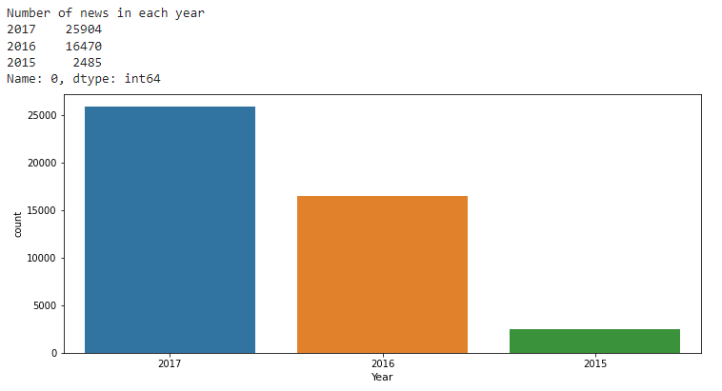
Majority of news are from year 2017.

Slide 8
Data Cleaning Procedure
First we append the news title to news text and drop the news title column.
Perform html parsing using beautiful soup, to scrap the text between html tags.
Next, we remove https and .com links from the text and then then split the text to convert it into lower case.
Then we remove all the numbers from the string and using regular expression sets, strip everything other than word and whitespace (like brackets, symbols etc)
Later we eliminate the stopwords and punctuations from the text.

Slide 9
We perform Lemmatization i.e. converting the word to its meaningful base form by looking at its context.
Since overstemming and understemming are two problems that can arise in stemming. For example, the word “fishing” might be overstemmed to “fishin,”.Hence lemmatization text preprocessing which has higher accuracy is preferred over stemming.
Lastly we remove any single character, if remaining in the text.
After data cleaning we perform more visualization.

Slide 10
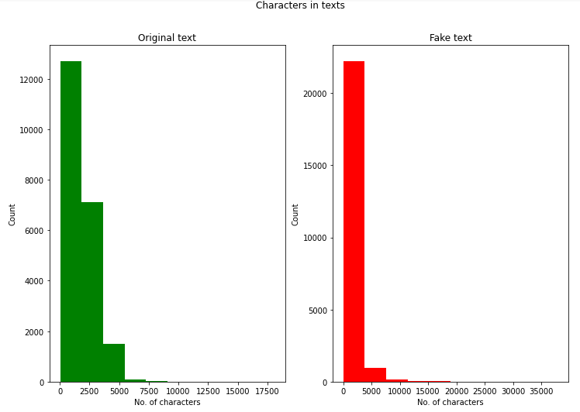
Approx. 2000 characters in text is most common in original text category
while approx 4000 characters in text is most common in fake text category.

Slide 11
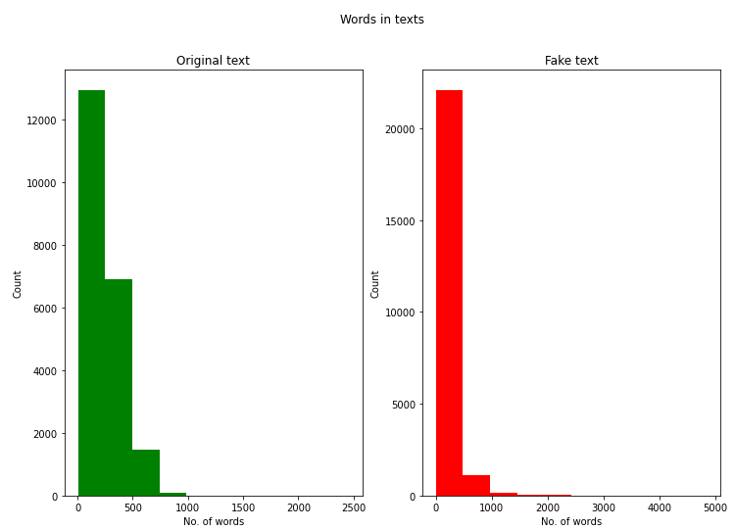
Approx. 250 words in text is most common in original text category
while approx 500 words in text is most common in fake text category.

Slide 12
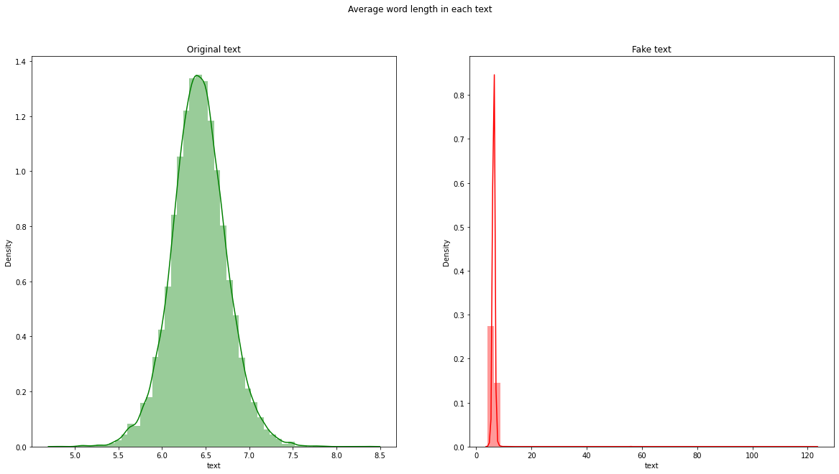
The average word length distribution in original text is greater than fake text.

Slide 13
Next we perform unigram, bigram and trigram analysis.
After computing word counts using ‘CountVectorizer’ we then compute the IDF values followed by Tf-IDF scores.
After that process is complete, we feed the Tf-IDF vectorizer data into the machine learning model for testing.
Then we select and save the best working model based on the results obtained.

Slide 14
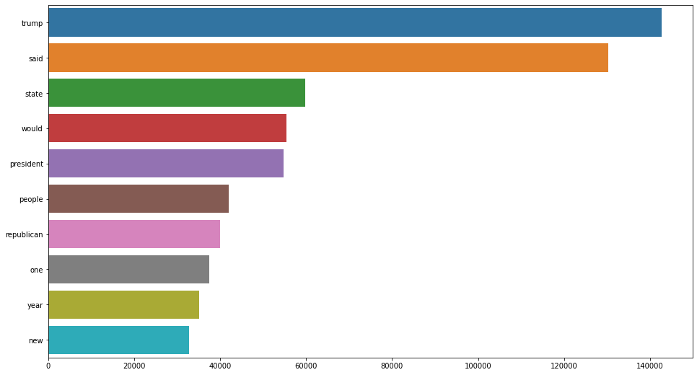
Unigram Analysis
Trump is the most repeated word in entire dataset text.

Slide 15
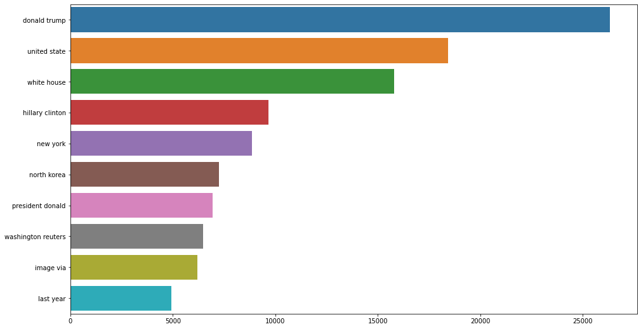
Bigram Analysis
Donald trump is the most repeated bigram in entire dataset text.

Slide 16
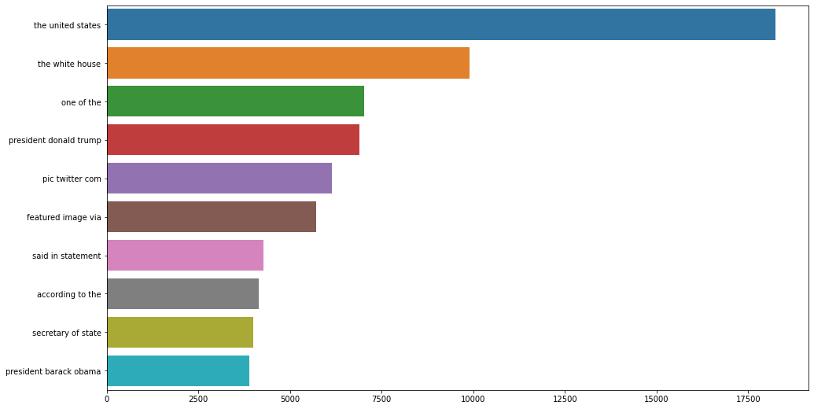
Trigram Analysis
The united states is the most repeated trigram in entire dataset text.

Slide 17
Conclusion
In this study we found that logistic regression algorithm performs slightly better than random classifiers and rest of the algorithm tested.
The average word length of text in the true news is larger than the text in the fake news.

